Slide 1
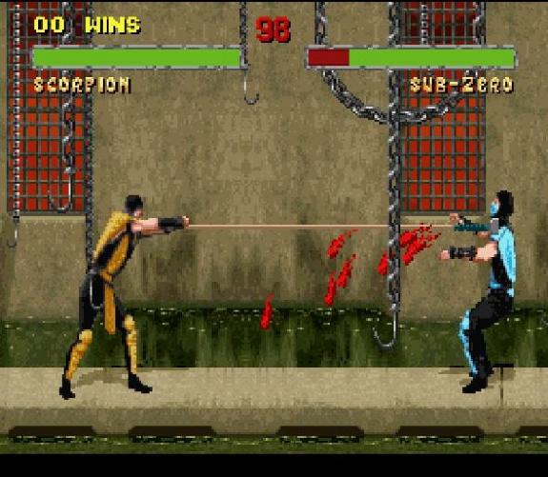
Video Game Violence and Aggression

Slide 2

Who has a stake in the “violent video games” debate?
Video games have always contained an element of danger
Parents
Politicians
The media
Developers
Educators
Consumers

Slide 3
Major Guiding Question
Do violent video games make players more aggressive/ desensitized to violence?
For example, was the 1999 Columbine shooting aided by the killers’ love of violent video games.
More realistically, do developers have an ethical obligation to limit and/or respectfully represent violence in games, lest they endorse, validate, and contribute to a culture of degradation?
OR is violent merely “lazy design”—a go-to cutch instead of creating more sophisticated mechanics?

Slide 4



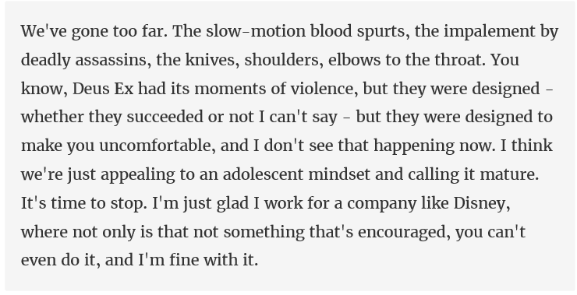
Warren Spector

Slide 5
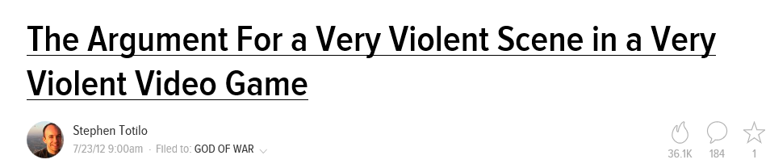
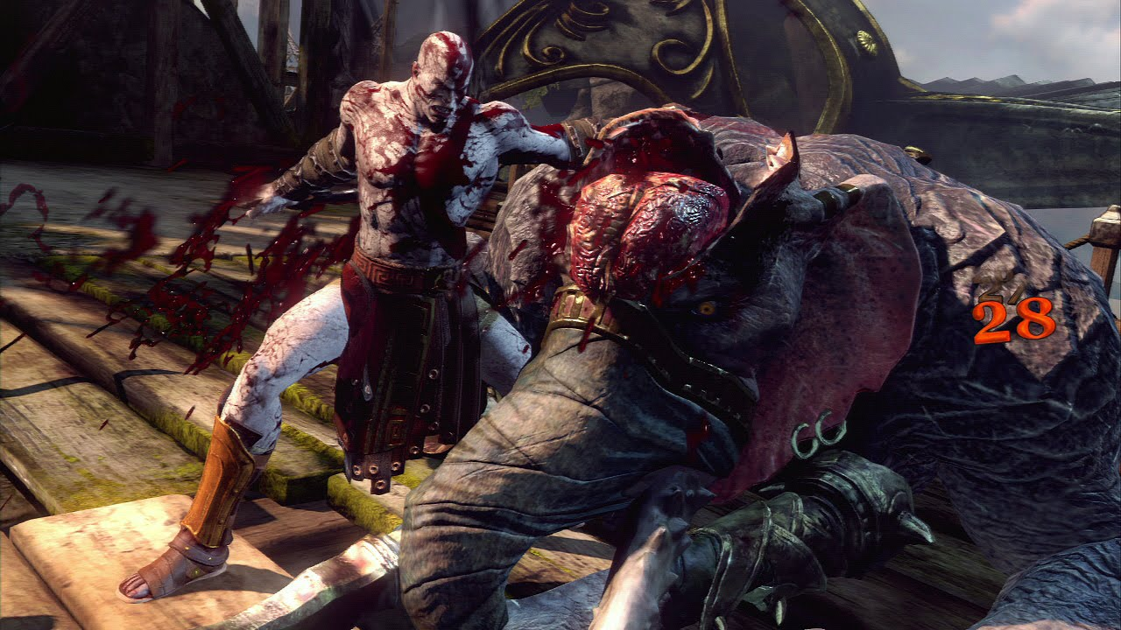

Slide 6
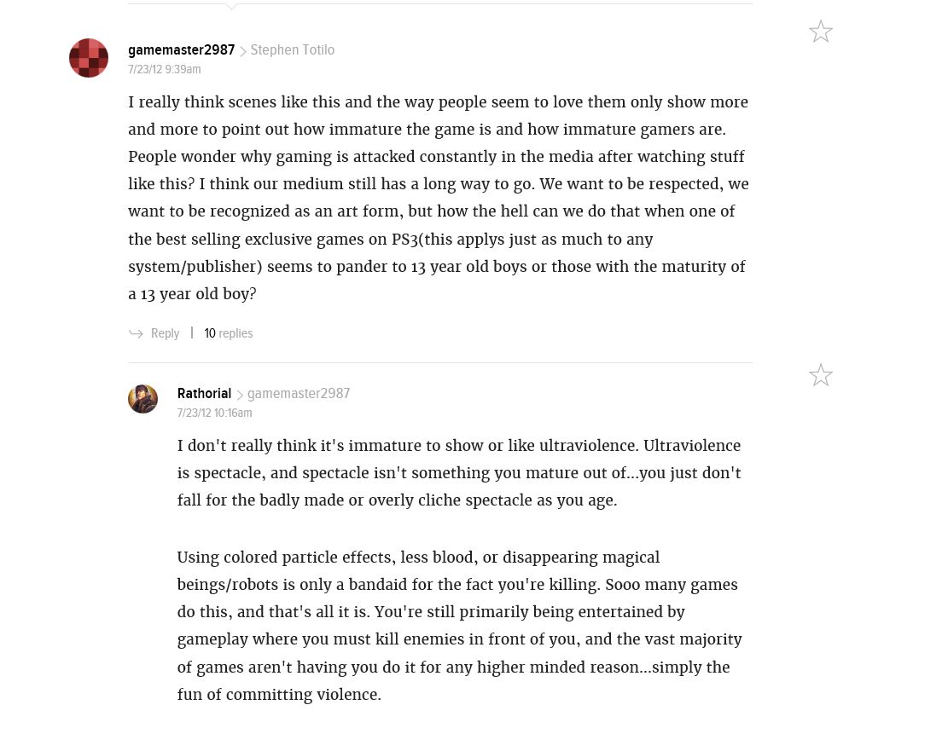

Slide 7


Slide 8
The “Mechanics” of Violence
Conflict is essential to narrative--you can’t have a plot without it.
Nothing creates more tension and player investment than ‘kill or be killed’ situations.
Life or death is a universal theme that everyone can relate to.
However, violence in games works in two ways: the suggestion of violence and the graphic depiction of it. Designers have full control over which method they wish to use.

Slide 9
Specific Gaming Controversies
Death Race (1976)
Doom (1991)
First Person Shooter Genre (1991-present)
Mortal Kombat (1994)
Grand Theft Auto 3 (2001)
Manhunt 1 and 2 (2003)
COD:MW 2—No Russian (2009)
Hatred (2015)

Slide 10

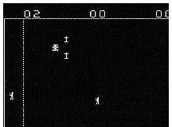
Death Race (1976)
First video game to inspire major protest and controversy in the United States.
Cars were to run over “gremlins” (looked like people)

Slide 11

Real-Life Result?
Nothing. Not linked to vicious killings or the inspiration for random hit-and-runs.
The National Safety Council called it sick and morbid. The CBS news program 60 Minutes did a show on the psychological impact of video games. It was also covered on NBC's Weekend news show, in the National Enquirer and Midnight magazine

Slide 12
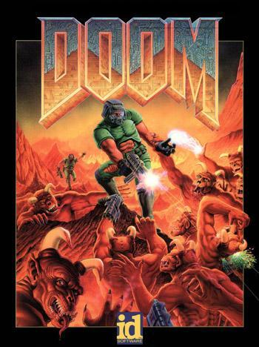
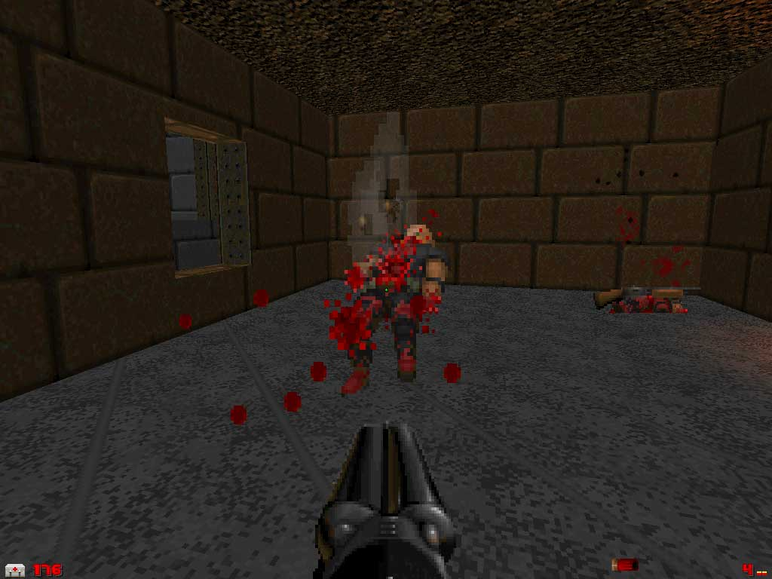
DOOM (1991)
Notorious for its high levels of violence, gore, and satanic imagery.

Slide 13


Real-Life Result?
Eric Harris and Dylan Klebold, who committed the Columbine High School massacre in 1999 were avid players of the game.

Slide 14

While planning for the massacre, Harris said that the killing would be "like fucking Doom" and that his shotgun was "straight out of the game.”

Slide 15
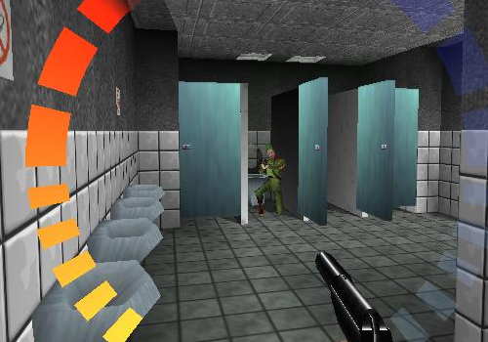
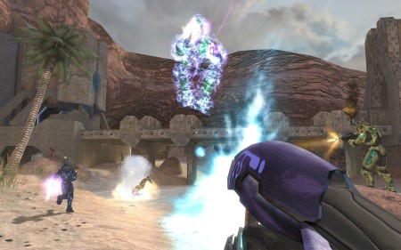
And the Research?
Harvard medical school researchers Cheryl Olson and Lawrence Kutner found that violent video games did not correlate to school shootings.
The U.S. Secret Service and Department of Education analyzed 37 incidents of school violence and sought to develop a profile of school shooters
They discovered that the most common traits among shooters were that they were male and had histories of depression and attempted suicide.

Slide 16
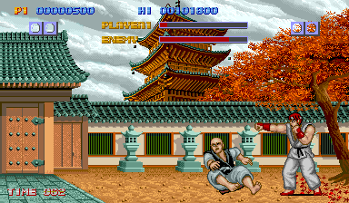
Prologue: Street Fighter
Series Developed by Capcom in 1987.
Debuted as an arcade game.
“Ryu” competes in a worldwide martial arts competition.
Moderately popular.

Slide 17
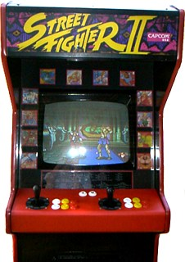
Street Fighter II: The World Warrior (1991)
The release of the game had an unexpected impact on gaming and was the beginning of a massive phenomenon.
The first one-on-one fighting game to give players a choice from a variety of player characters with different moves.
This option created unknown levels of depth and replay value—a first for an arcade game.

Slide 18
Super NES, Genesis, Super NES
Street Fighter 2 ported to the SNES in 1992. As of 2008, the original SNES game is still Capcom's best selling game.
Genesis gets Street Fighter II: Special Champion Edition in 1993.
Nintendo flips out. They get Street Fighter II: Turbo Edition in 1993.
Other releases follow (too damn many!)

Slide 19
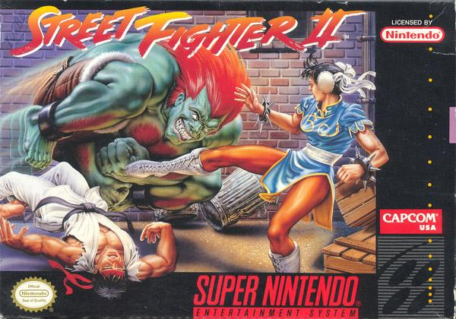
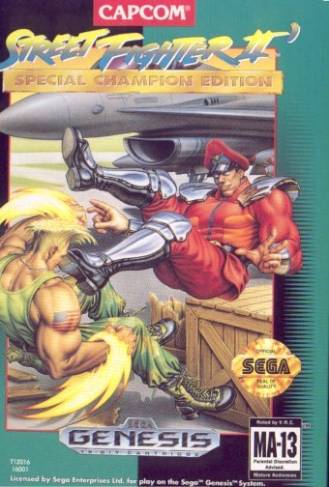
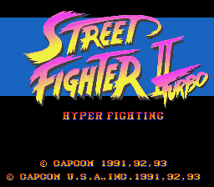
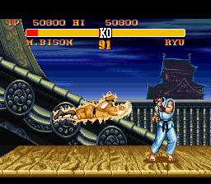
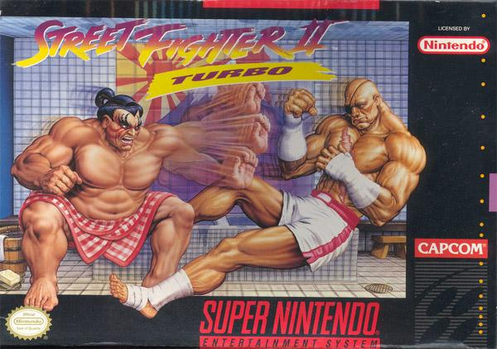
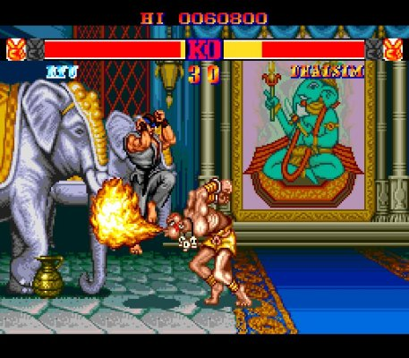
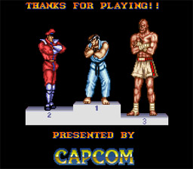
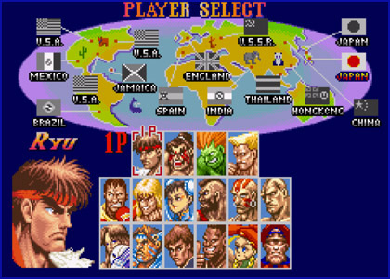

Slide 20
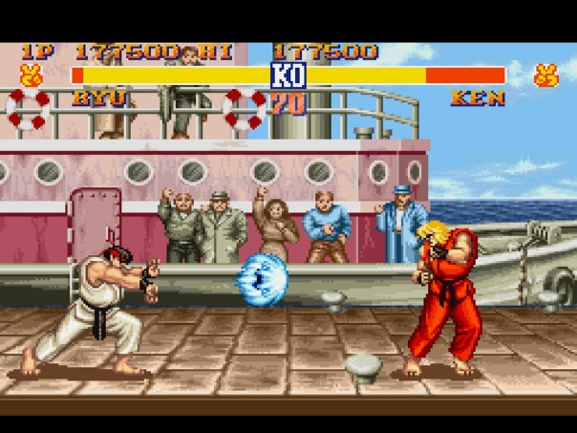
Zangief vs Guile - Street Fighter II - SNES - YouTube

Slide 21

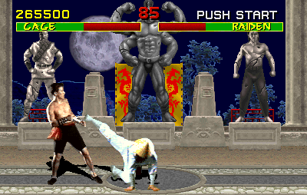
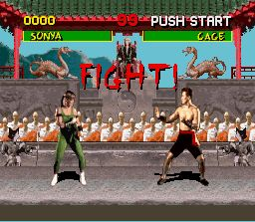
Mortal Kombat (1994)
Mortal Kombat was developed as a direct response to Street Fighter II.
The game featured digitized sprites based on actors, as opposed to animated graphics.

Slide 22

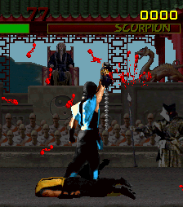
Fatalities
Game was most popular (and controversial) because of “fatalities” (finishing moves) players could perform on defeated opponents through a series of button combos.

Slide 23
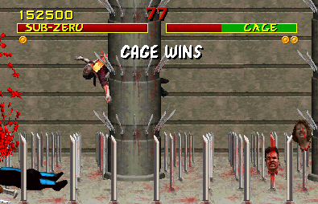

Slide 24

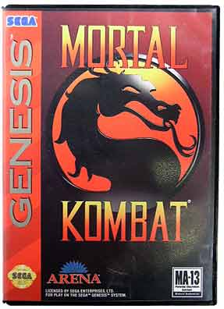
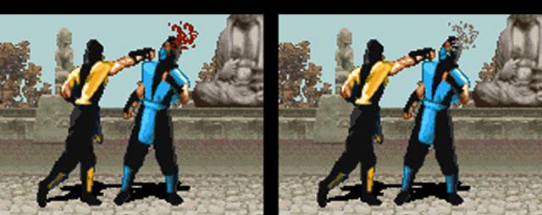
Home Ports
Sega Genesis (1993): Version was modified, but entering a “secret” cheat code restored the full gore and fatalities from the arcade version.
SNES (1993): version contained modified gray “sweat” in place of blood. Graphically superior, but….not as fun.

Slide 25
Real-World Result?
Nothing. Not linked to vicious killings or inspiring murder.
Previous to GTA, MK was always at the centre of discussions about violent video games.
Many sequels are released. MKII featured “friendly” fatalities such as “babalities” (turn opponent in to a baby) and “friendships” (give opponent a gift).

Slide 26
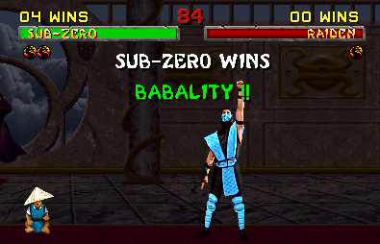
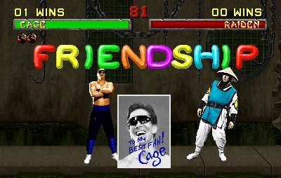

Slide 27
The Entertainment Software Rating Board (ESRB)
Due to public outcry and horror over Mortal Kombat, the government tells the video game industry “regulate yourselves or we’re going to do it for you.”
Thus, the ESRB was formed in 1994 to act as a self-regulatory body for the video game industry (comparable to the MPAA for films)
The ESRB independently applies and enforces ratings, advertising guidelines, and online privacy principles adopted by the industry.

Slide 28
The Entertainment Software Rating Board (ESRB)
ESRB ratings have two parts:
A rating symbol suggesting the age group that the game is appropriate for. This provides general information about the game’s content.
Multiple content descriptors providing additional details on game content. These include alcohol references, blood, drug references, gambling, mature humour, mild or strong language, sexual content, violence, tobacco references, and so on.

Slide 29








The Entertainment Software Rating Board (ESRB)
Early childhood, for ages 3 and up. Contains no inappropriate content.
Mature, for ages 17 and older. May contain mature sexual themes or intense violence and language.
Everyone, suitable for ages
6 and older. May contain minimal or comic violence or mild language.
Adults only; content suitable only for adults 18 and older. May contain graphic depictions of sex and/or violence.
Everyone 10 and older. May contain more mild violence, mild language, or suggestive themes.
Rating pending; the product has been sent to the ESRB and is awaiting its final rating.
Teen; content suitable for ages 13 and older. May contain violence, strong language, and suggestive themes.

Slide 30
Video Game Violence and the ESA
Naturally, the ESA claims that violent video games are harmless:
Additionally many studies carried out by reputable scientists indicate that there is no correlation between violence in games and violence or aggressive behaviour.
Violent crime among young people has decreased dramatically since 1990, while video game popularity has increased at the same time.
‹#›

Slide 31

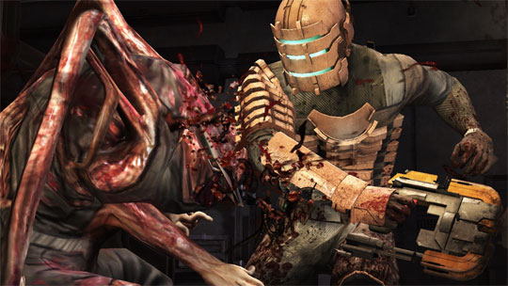

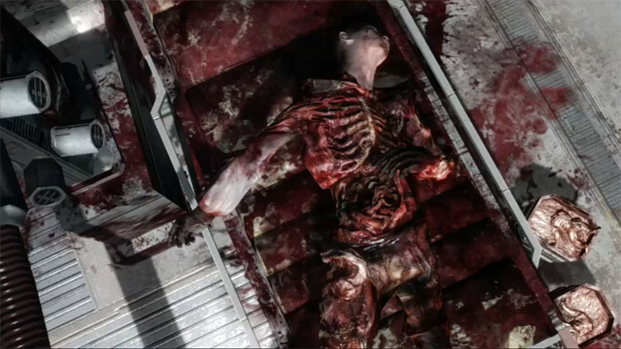
Violence often seems more acceptable when the victims are zombies, necromorphs, or other (undead) creatures.

Slide 32
Accessibility Vs. Responsibility
That said, unlike guns, drugs or alcohol, video games (or media in general) is easily accessible by children—this is the reality.
Do developers have an ethical obligation to limit violence (or to make it “meaningful” in their games) knowing that some of these games will end up being played by children?

Slide 33

Extreme Gore as Satire/humour
Some cultural critics argue that all extreme examples of media violence (film, TV, video games) are satirizing our culture and our bodies.
Violence as camp and extreme over-the-top gore as humour: a type of release regarding our anxieties of death and dismemberment.
EVERY Mortal Kombat Fatality EVER - YouTube
Leatherface

Slide 34
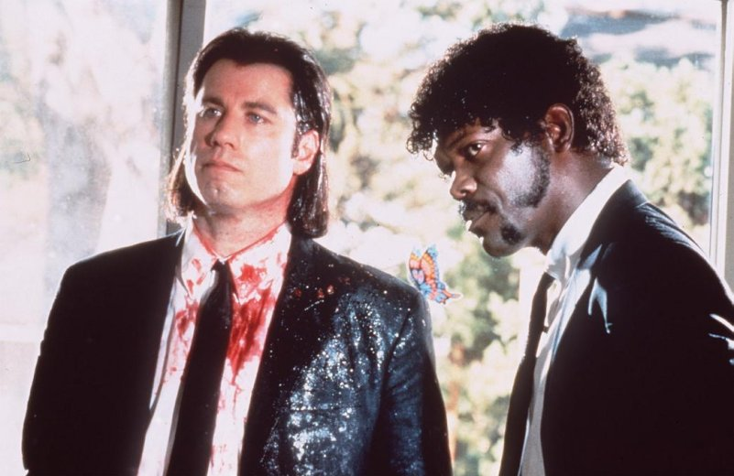
Tarantino is particularly good at exploiting this: shot from Pulp Fiction

Slide 35



Kill Bill 1 and 2

Slide 36


Horror films have a long tradition of mixing gore with laughs…

Slide 37


Scapegoats! Censorship!
Some believe “the discussion of video games and aggression is essentially an attempt to turn games into a scapegoat for more complex societal problems” (255) like gun ownership.

Slide 38
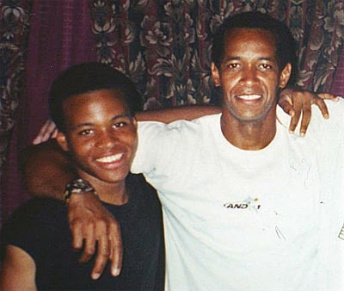
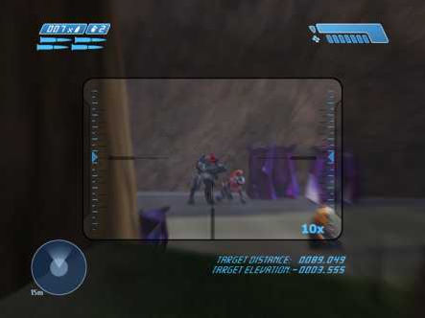
Halo (2001)
John Muhammad & John Lee Malvo, the Beltway Sniper duo in Washington: killed 10 people and injured 3 in 2002.
Malvo—17—trained for sniping people using the sniper mode on Halo, to improve skills and break down inhibitions to kill.

Slide 39
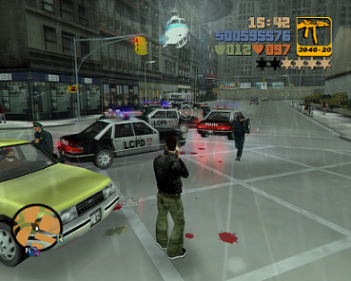
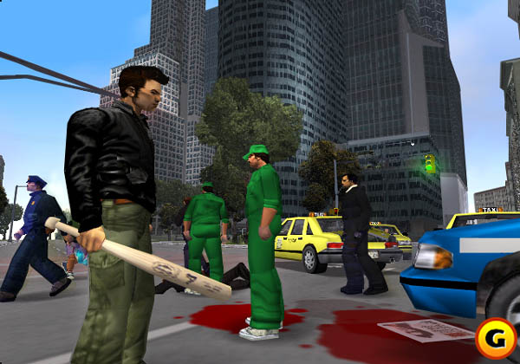
Grand Theft Auto III (2001)
Exceptionally critically acclaimed
Remains very controversial because of its violent and sexual content.
Responsible for an alarming amount of real-life inspired tragedies.

Slide 40


Dustin Lynch, Ohio, USA
Dustin Lynch, aged 15, allegedly played GTA 3 extensively to prepare to beat JoLynn Mishne to death
He then stole her car, for no reason, as is often done in game.

Slide 41
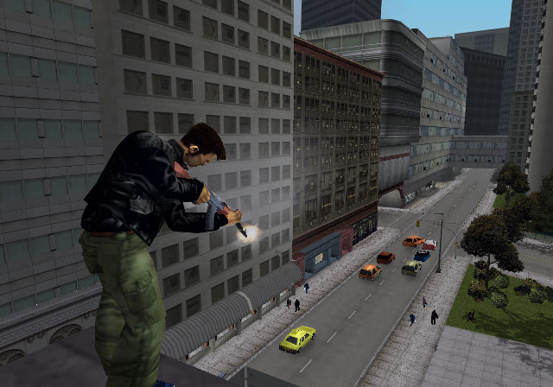
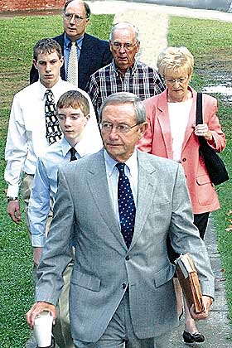
William and Joshua Buckner, Tennessee
Opened fire on vehicles on the Interstate 40 highway in Tennessee with a .22 calibre rifle, killing one person and injuring another severely.
Said they were “bored,” and decided to copy their favourite videogame: GTA 3

Slide 42
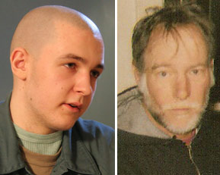
Andrew Ihrcke, Luis Oyola, and Nathan Moore, Milwaukee
Admitted to killing Rex Baum, a homeless man.
Continued to beat Baum until he stopped moving and then stabbed him twice to see if he would “make the same sound” as a person who's killed in Grand Theft Auto III.

Slide 43

Devin Moore, Alabama, USA
Arrested for possession of a stolen car and was awaiting booking when he grabbed a police officer's sidearm and shot and killed three officers.
During the trial, Moore’s defense claimed he was severally influenced by the videogame Grand Theft Auto III, and that he could not distinguish reality from the game.
Moore told Investigators after his arrest, "Life is a video game; everybody has to die sometime."

Slide 44

Manhunt 1 and 2 (2003)
Released by Rockstar Games in November 2003.
Created a controversy due to the graphic violence the player is encouraged to engage in.

Slide 45
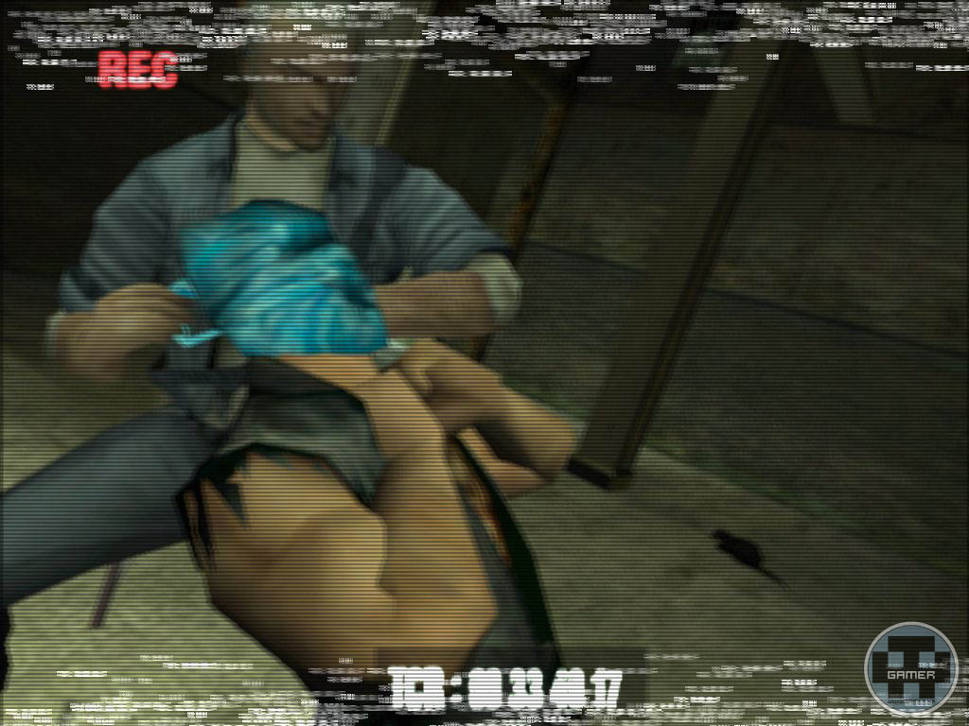
Objective
Main character must kill to please a “hidden” TV audience.
Game is a glorified snuff film.
Received moderate critical praise.

Slide 46
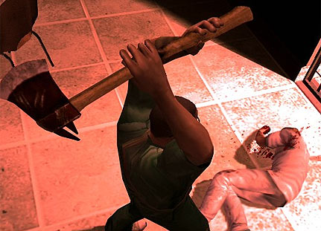
Legal Status
New Zealand: Possession is an offense
Germany and Australia: Banned.
Manhunt became the first computer game in Ontario to be classified as a film and was restricted to adults only on February 3, 2004.
YouTube - Manhunt - Executions (High Quality)

Slide 47
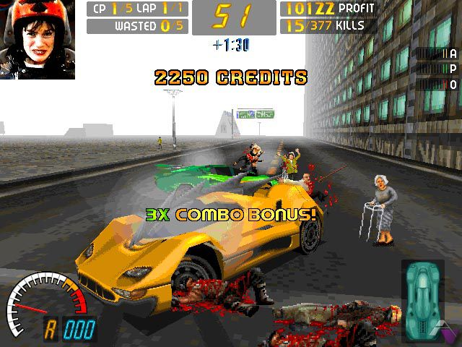
Video Game Violence
Carmageddon: . After completing the game, the player will have had the chance to kill roughly 33,000 people, including children and elderly women with walkers.

Slide 48

Postal Series (2003-present)
The “Postal Dude” must complete daily tasks in “Paradise”
He can be as violent or non-violent as he wants (the developers like to point this out)
That said, the weapons are easily accessible and the game is rife with sexism, racial stereotypes, and violence.

Slide 49
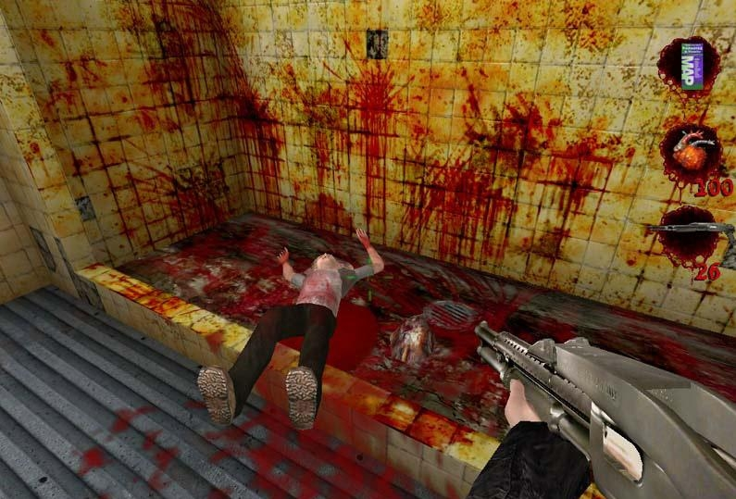
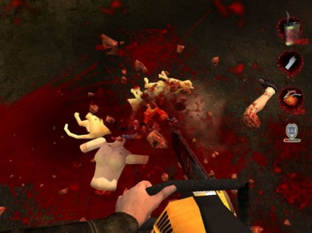
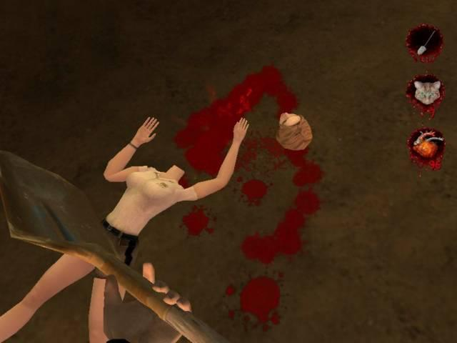
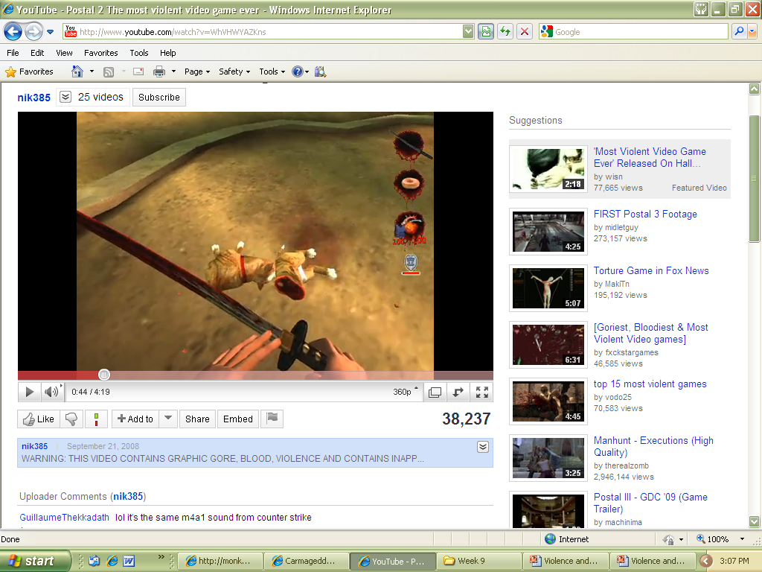
New Zealand banned Postal 2 outright because of its high level of violent content, animal violence and a scene that was considered "gross and abhorrent" where the player urinates on dead bodies at a terrorist camp.

Slide 50


Real Life Violence
Kimveer Singh Gill of the Dawson College Massacre in Quebec (1 dead, 19 wounded).
His favourite games listed in his online profile were “GTA, COD, Postal, Max Payne, Manhunt, DOOM, Quake, etc”

Slide 51
Call of Duty: MW2 (2009) “No Russian” Mission
An optional level early in the game entitled "No Russian" has the player assume control of a deep-cover CIA agent, joining a group of Russian nationalist terrorists enacting an airport massacre.
The player is warned prior to starting the single player campaign of the mission's "disturbing content", and can choose to skip the mission in advance, at no penalty

Slide 52
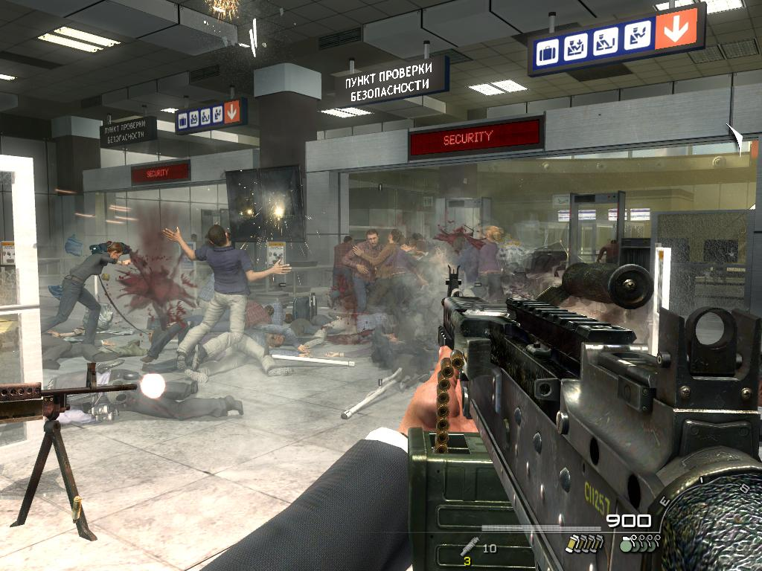
Modern Warfare 2 - "No Russian" Airport Mission

Slide 53
“No Russian” Reaction
This controversial mission was removed from the Russian version of the game.
The Japanese and German versions of Modern Warfare 2 were modified to give players a "game over" if they kill civilians
UK and US—many strong opinions on both sides, but no bans. The game was held to the same standards as film, television, and books—meaning buyer/viewer beware.

Slide 54

Anders Behring Breivik
Norwegian responsible for killing 69 people in 2011.
Used Call of Duty: Modern Warfare 2 for "training-simulation."
Told a court in April 2012 that he trained for shooting using a holographic device while playing Call of Duty. He claimed it helped him target.

Slide 55

Hatred (2015)
A nihilistic, mass murder-simulator (essentially). Rated Adults Only.
Criticized for crossing the line between meaningful violence and sadism
Poorly reviewed. Boring repetitive gameplay.
No (measurable) real world result (of course remembering that media’s influence isn’t a 1:1 ratio).
Hatred Gameplay Trailer

Slide 56


Video Game Violence: One Perspective
“We are teaching children to associate pleasure with human death and suffering. We are rewarding them, for killing people. And we are teaching them to like it.” - Lt. Col. David Grossman, U.S. Army psychologist specialized in training soldiers to kill without hesitation, in an ABC News interview.

Slide 57
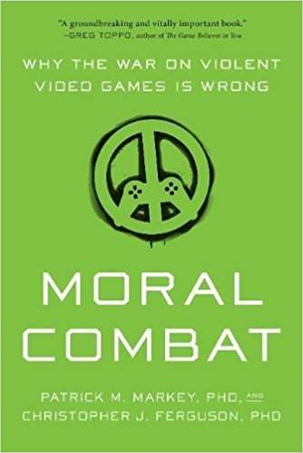
Video Game Violence: Another Perspective
Book released in 2017 and written by two psychologists.
Positively reviewed and praised as a more measured and less alarmist approach to the violent media debate.
It’s conclusion: statistical evidence does not link violent crime to playing video games.

Slide 58

Well, it’s official…
In 2015 the APA published a large, landmark report linking playing violent video games with aggression (but not criminal activity) in certain susceptible people.
Of course every random Joe commenting on the internet calls it BS and is all defensive, but you know, there we are:
APA Review and Report--click here and follow link to doc

Slide 59
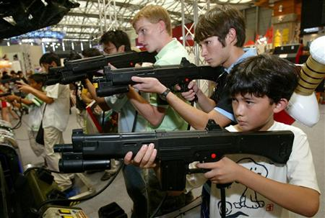
“No single risk factor consistently leads a person to act aggressively or violently,” the report states. “Rather, it is the accumulation of risk factors that tends to lead to aggressive or violent behavior. The research reviewed here demonstrates that violent video game use is one such risk factor.”

Slide 60
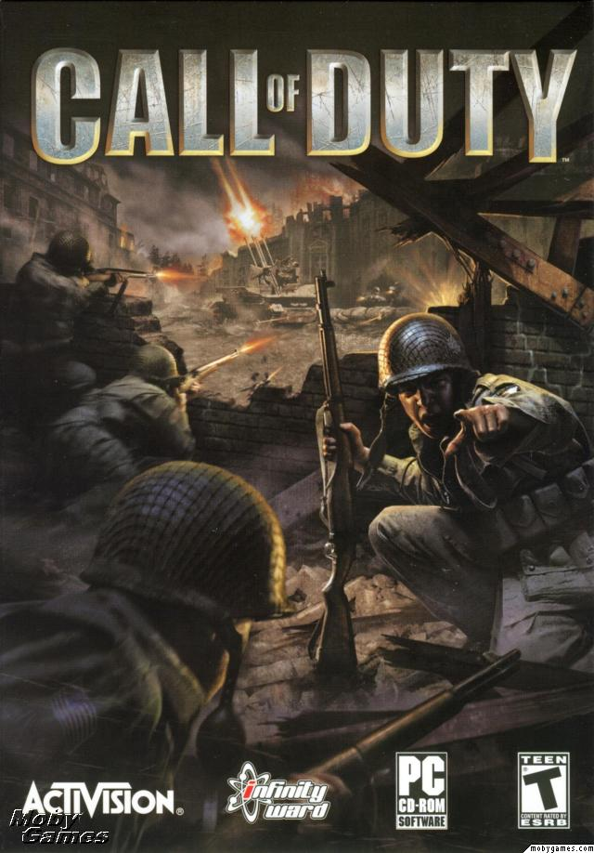

One Parent’s Response
Art of playing nice
When 13-year-old Evan Spencer wanted to play the ultraviolent video game Call of Duty, his parents gave him the green light, on one condition: He had to follow the Geneva Conventions.
SARAH BOESVELD, The Globe and Mail, March 3, 2009
Violent video games can encourage learning - The Globe and Mail

Slide 61

Final Remarks
Brian Moriarty, 1998 Game Developers Conference:
"If you want to include violence in your games … put your heart and soul into it, do it with awareness – not because violence is easy, or because it shocks, but because you need dissonance, and you know how and why it strengthens your game."

